Slide 1
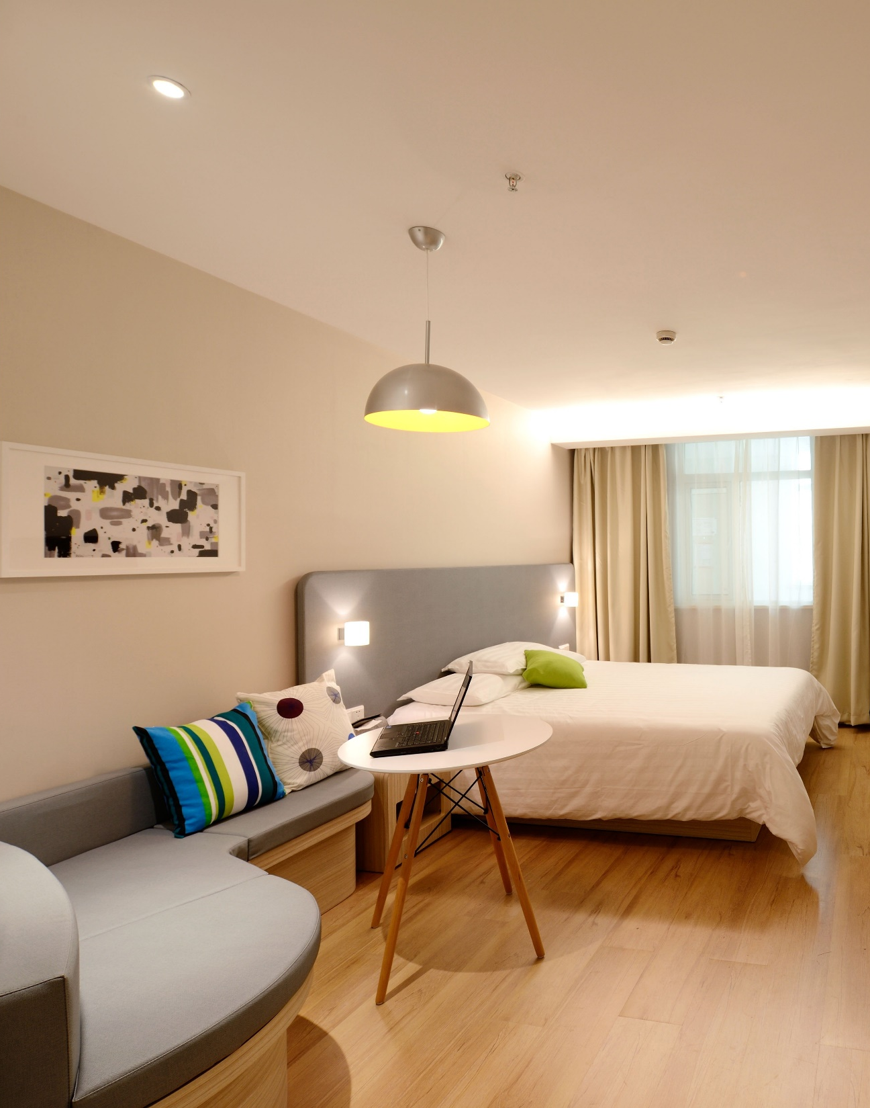

h a c k i n g

Slide 2




Market Size
700 Million
432+ Billion €
135 Million
Trips Booked (Worldwide, est.)
Budget & Online Trips
Trips with AB&B
Serviceable Available Market
Market Share
Total Available Market
h a c k i n g

Slide 3



WHY?
Price
Customer Satisfaction
No Easy Way Exists
Is an important concern for your booking travel online.
Seems random to Hosts
To know, which factors influence Price and Satisfaction Rating
h a c k i n g

Slide 4
WHAT?
OLS Modeling
Accomodation data
Locality data
Price
Customer Satisfaction
h a c k i n g

Slide 5





HOW?
Data Exploration
Data Cleaning & Encoding
OLS Modeling
Model Validation
Model Application
h a c k i n g

Slide 6
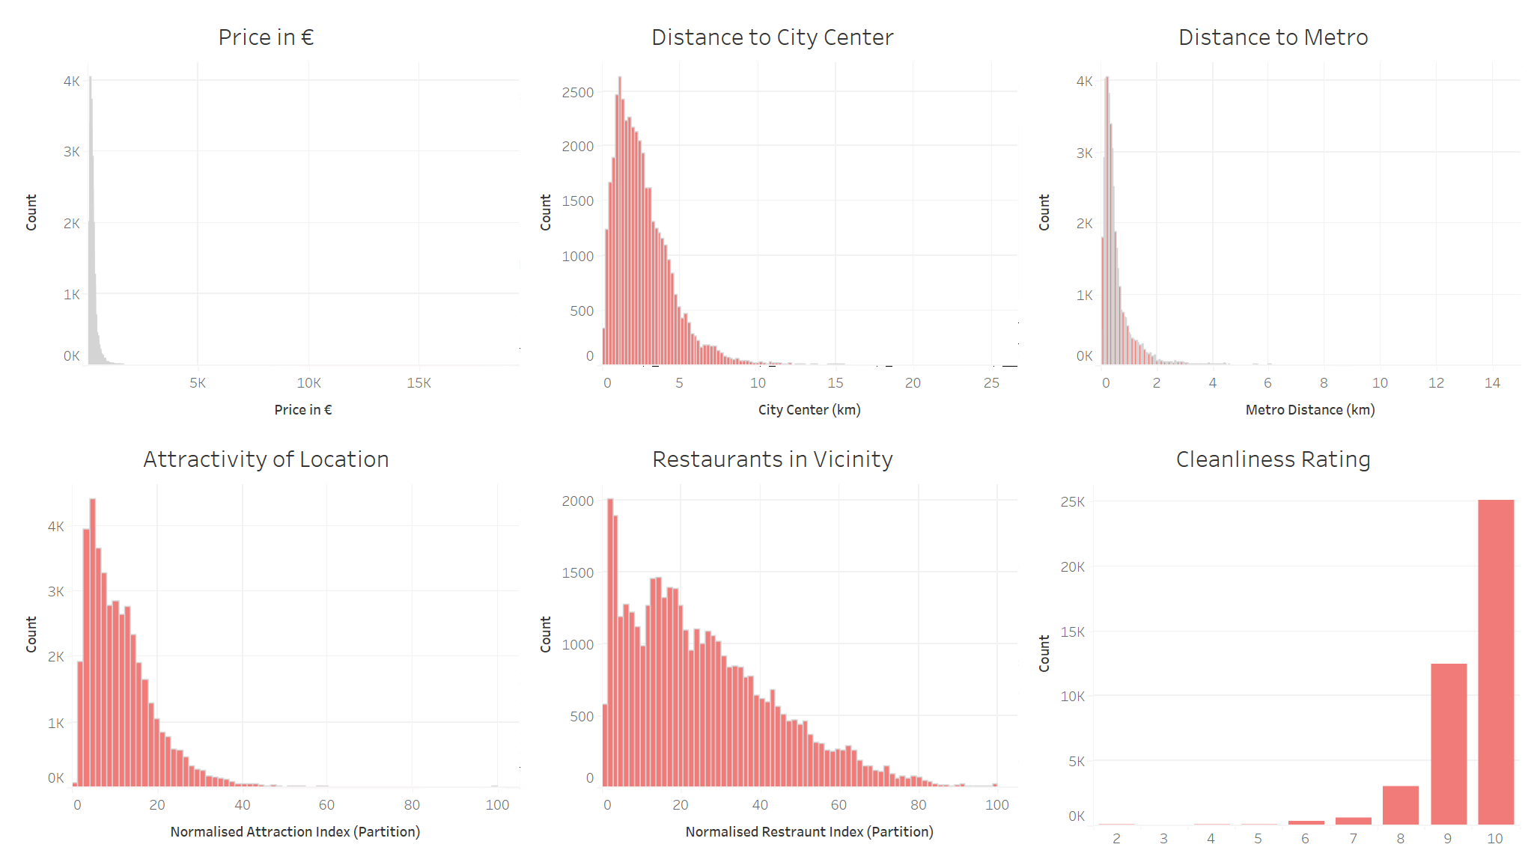

41.714 Observations
19 Parameters
from 9 European Cities
10 float, 3 integer, 3 object, 3 boolean
No NaN
but unexpected Zero-Values
h a c k i n g

Slide 7
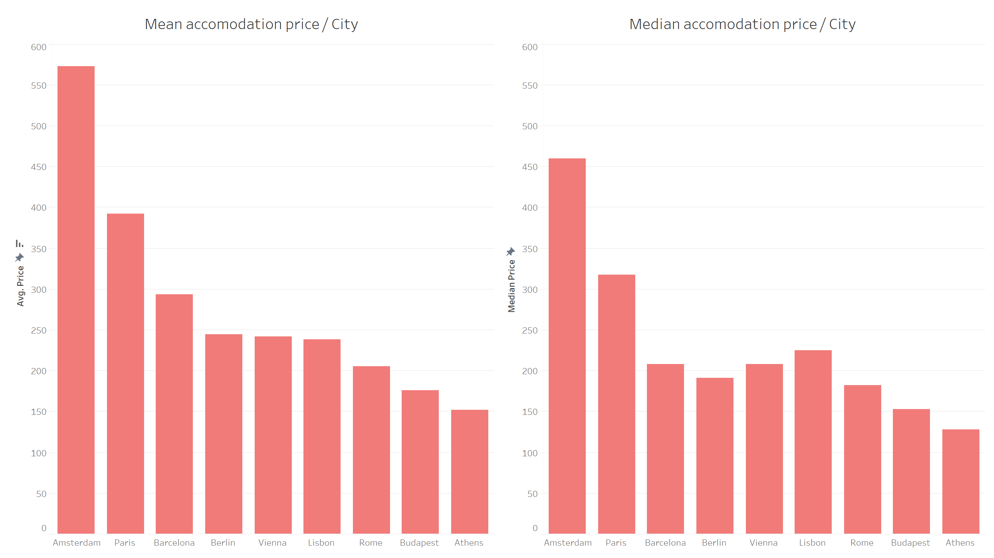
h a c k i n g

Slide 8
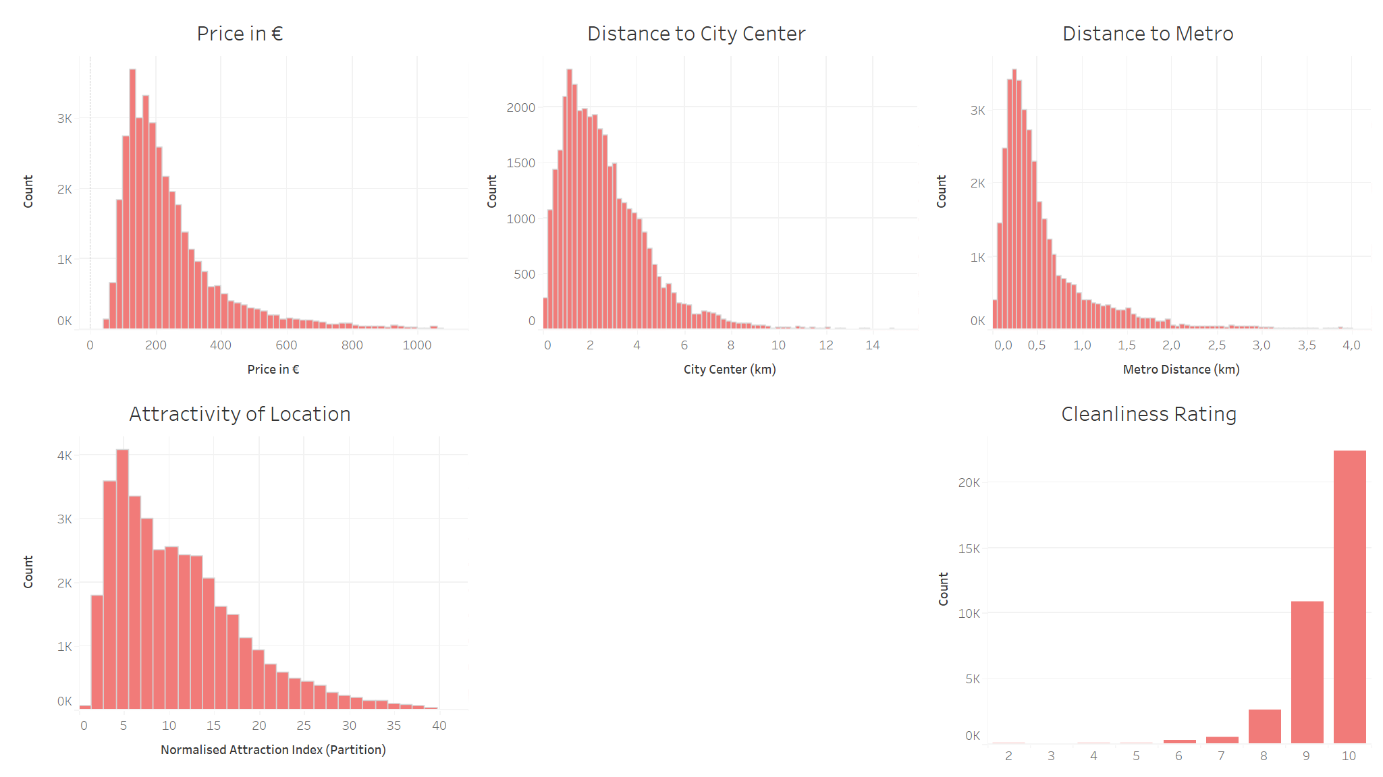
99% Cut-off
City Center (km) > 15 Bedrooms > 3
Metro Distance (km) > 4 Price > 1100
h a c k i n g

Slide 9
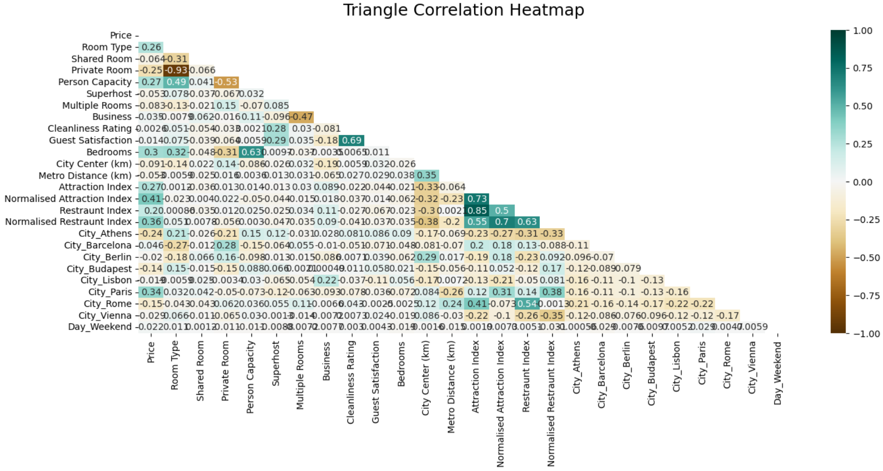
Normalised Attraction Index - Attraction Index, Restraunt Index, Normalised Restraunt Index
Room Type - Shared Room, Private Room
Cleanliness Rating - Guest Satisfaction
Bedrooms - Person Capacity
h a c k i n g

Slide 10
Normalised Attraction Index
Room Type
Cleanliness Rating
Bedrooms
h a c k i n g

Slide 11
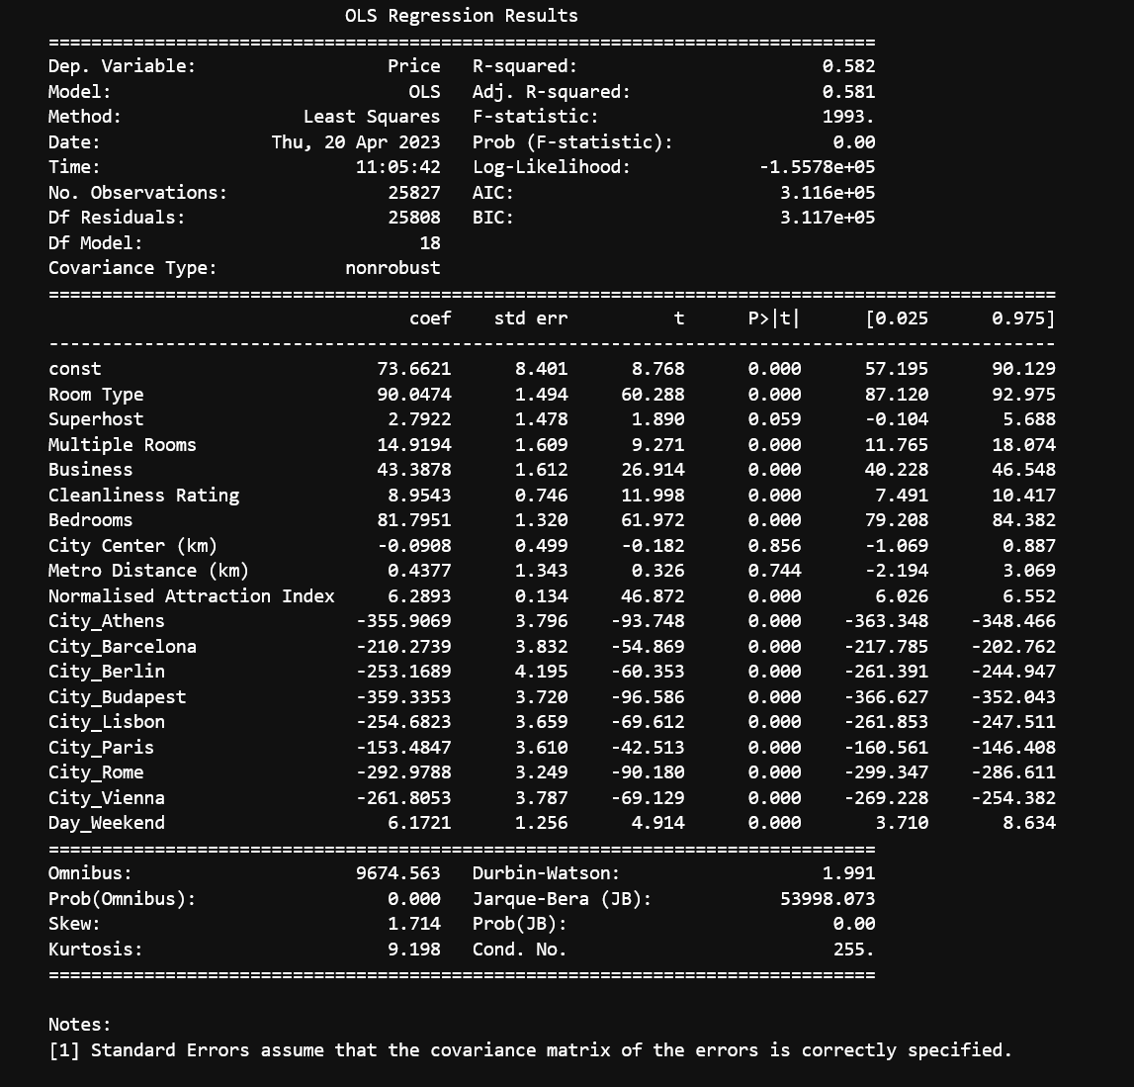
1st Iteration
h a c k i n g

Slide 12
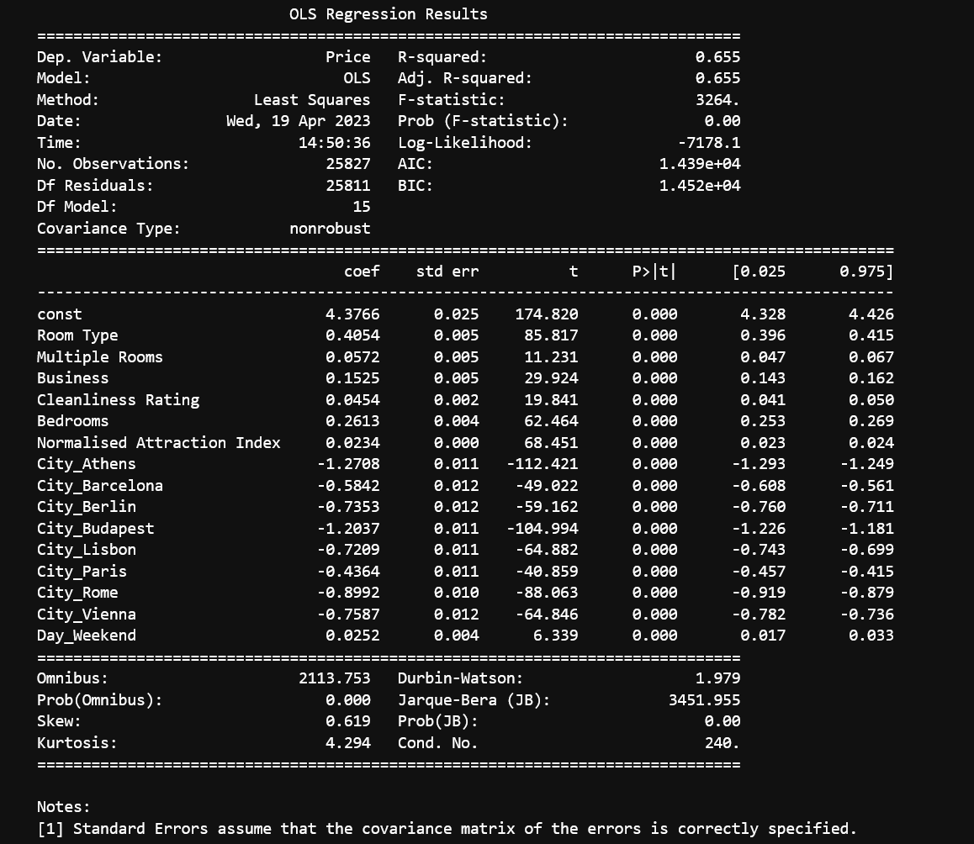
3rd Iteration
log scaling of y
h a c k i n g

Slide 13
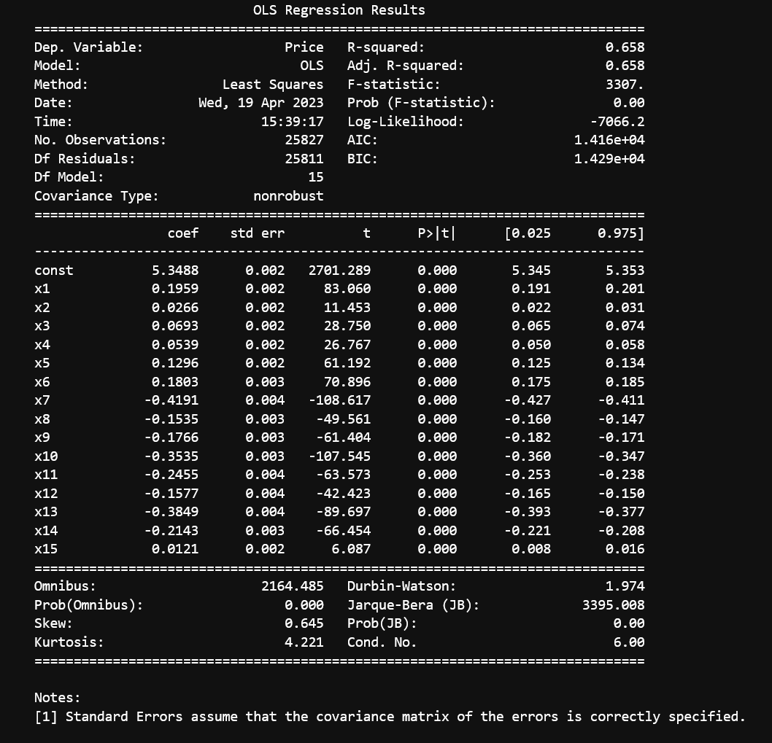
5th Iteration
log scaling of y
h a c k i n g

Slide 14
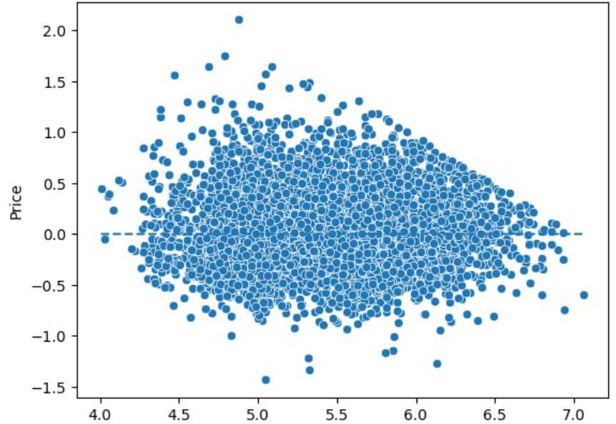
h a c k i n g

Slide 15
h a c k i n g

Slide 16
h a c k i n g

Slide 17
https://d.docs.live.net/4d50a533e7571b85/Dokumente/Modellvergleich.xlsx
h a c k i n g

